Slide 1













digiresult
New Horizon Institute of Technology and Management, Thane
Department Of Computer Engineering
BY
Rahul Jalora,12242040
Rohit Joshi, 12212044
Varun Joshi, 12222007
Guided By: Ms. Vaishnavi Mestry

Slide 2
Problem statement & objectives
Problem Statement: The main challenge addressed by the DigiResult system is the inefficiency and unreliability of existing result management systems, especially during critical times when students access their results. The following objectives have been identified:
Objectives:
Streamlining Result Distribution: Allowing college administrators to upload results in real time for instant access.
Enhancing Accessibility: Developing a mobile-responsive platform for easy access on various devices.
Improving Performance: Ensuring smooth performance even under high traffic through optimized code and cloud hosting.
Secure Data Management: Incorporating encryption and user authentication to protect sensitive data.

Slide 3
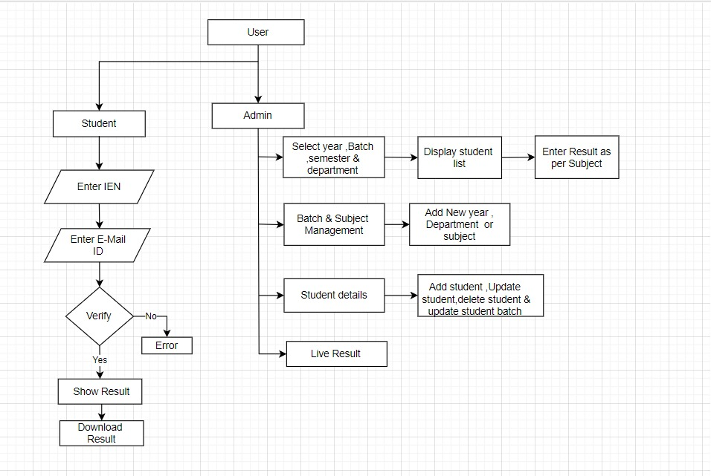
workflow

Slide 4
IMPLEMENTATION DETAILS
Week | From | To | Plan
1 | 24-07-24 | 30-07-24 | Discussed 3 Topics : Gemini Chatbot,Lawyer Portfolio,Online Auction app.
2 | 31-07-24 | 6-08-24 | Finalised 1 topic - Student Result Management System.
3 | 7-08-24 | 13-08-24 | Started Requirement gathering and developing the workflow.
4 | 14-08-24 | 20-08-24 | Build basic UI design for login & developed some webpages on admin side.
5 | 21-08-24 | 27-08-24 | Created MySQL database and connected to the admin side student details page.
6 | 28-08-24 | 4-09-24 | Error handling and developing the logic.

Slide 5
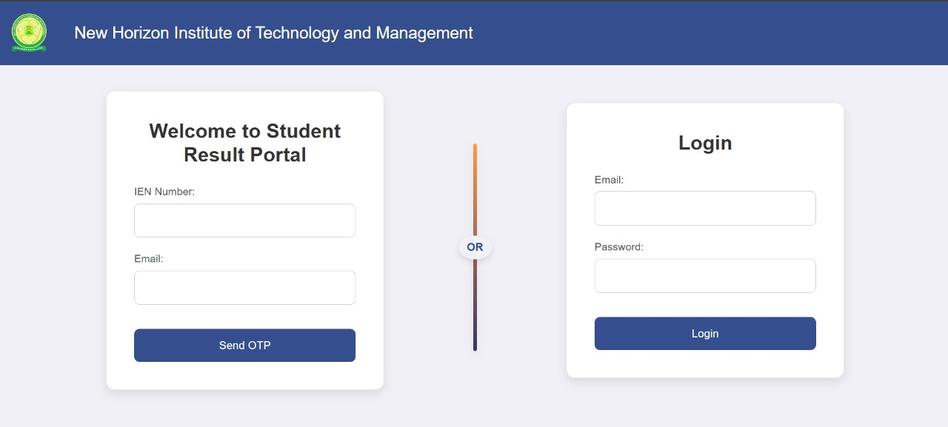
RESULT SCREENSHOTS

Slide 6
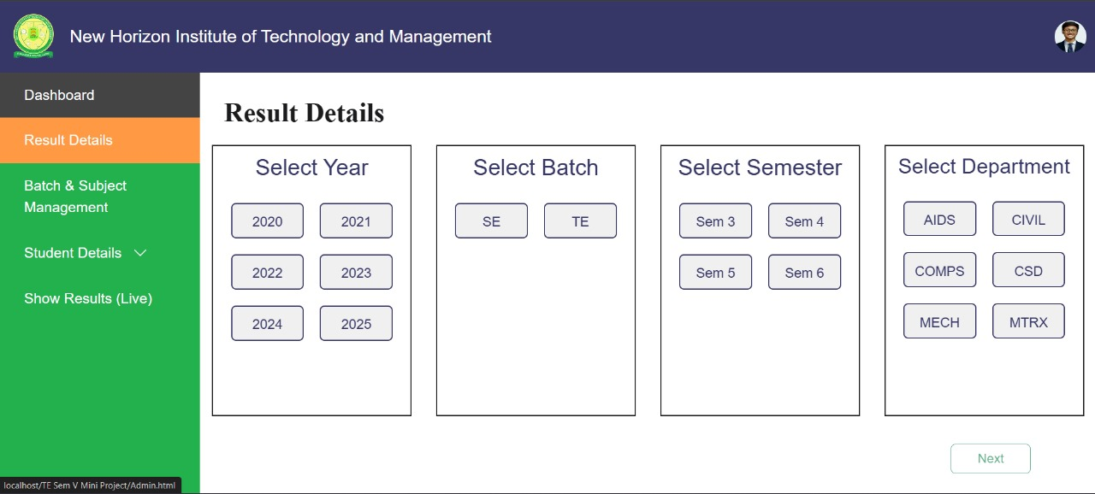
RESULT SCREENSHOTS

Slide 7
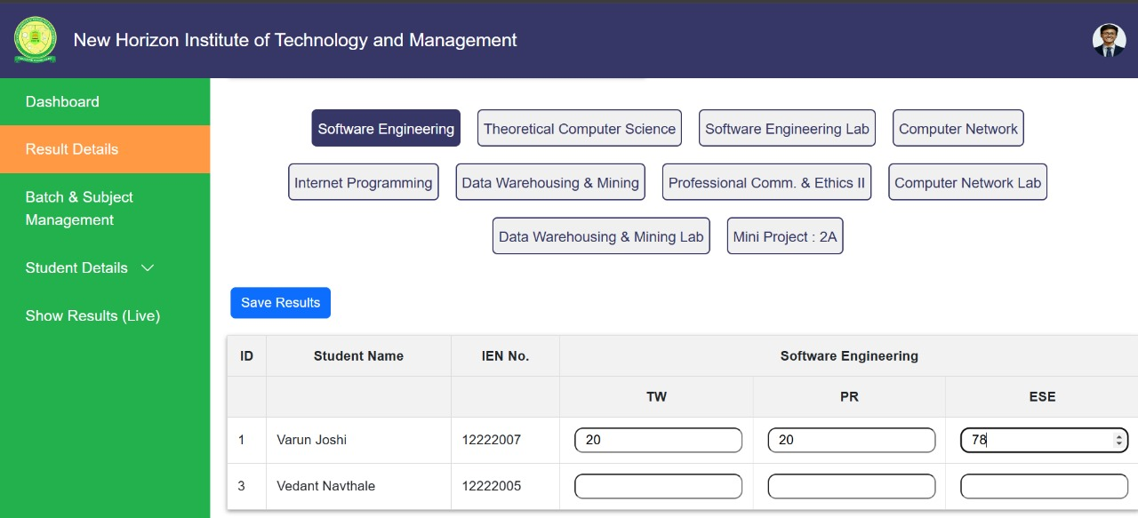
RESULT SCREENSHOTS

Slide 8
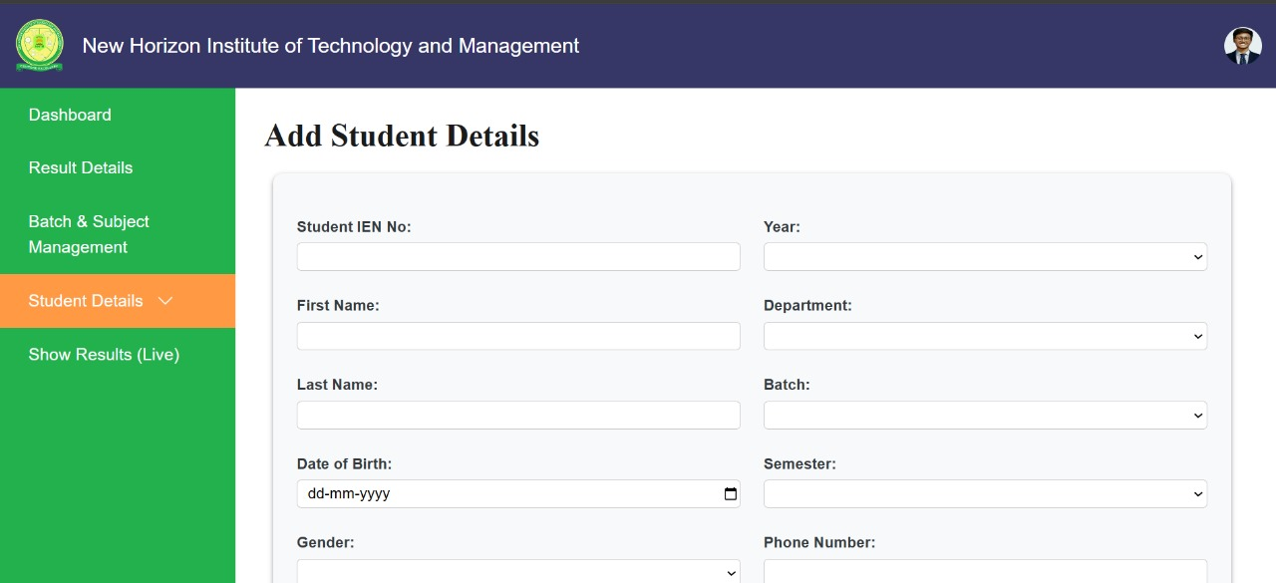
RESULT SCREENSHOTS

Slide 9
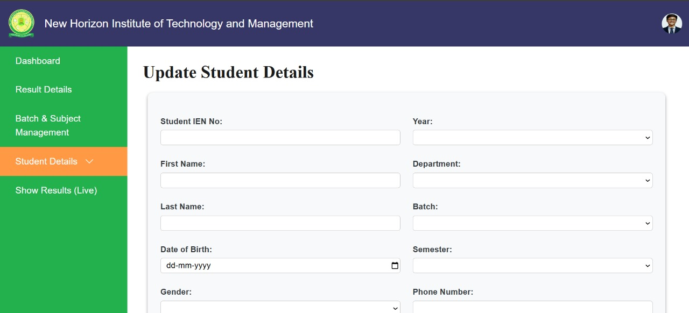
RESULT SCREENSHOTS

Slide 10
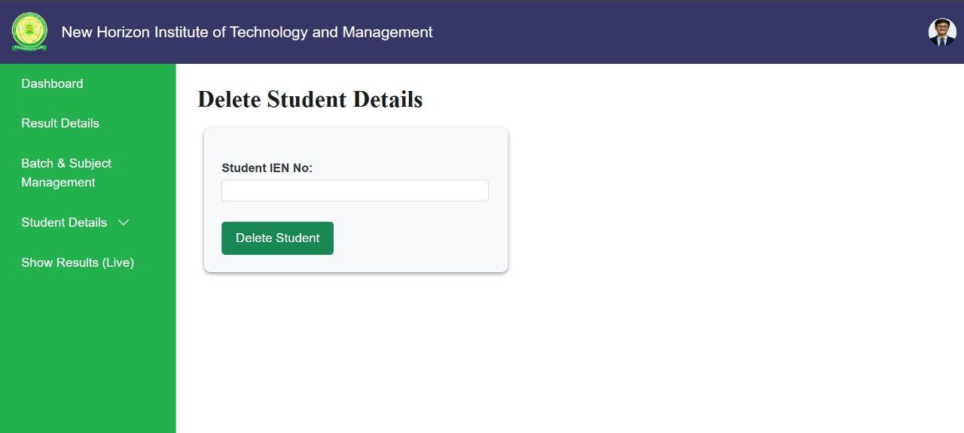
RESULT SCREENSHOTS

Slide 11
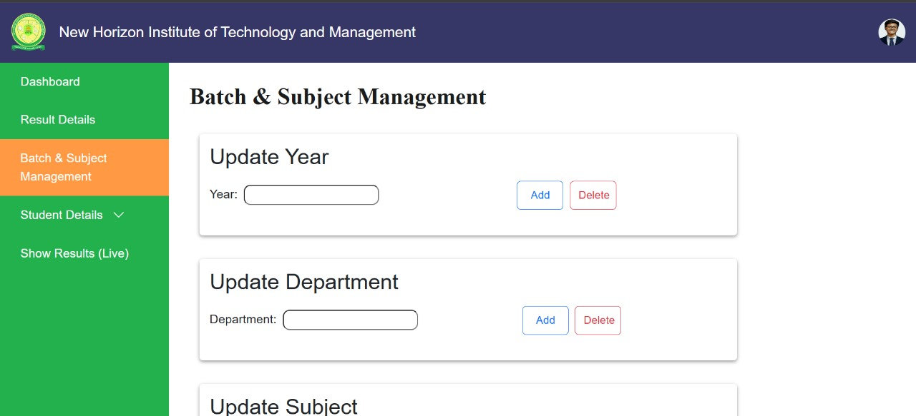
RESULT SCREENSHOTS

Slide 12
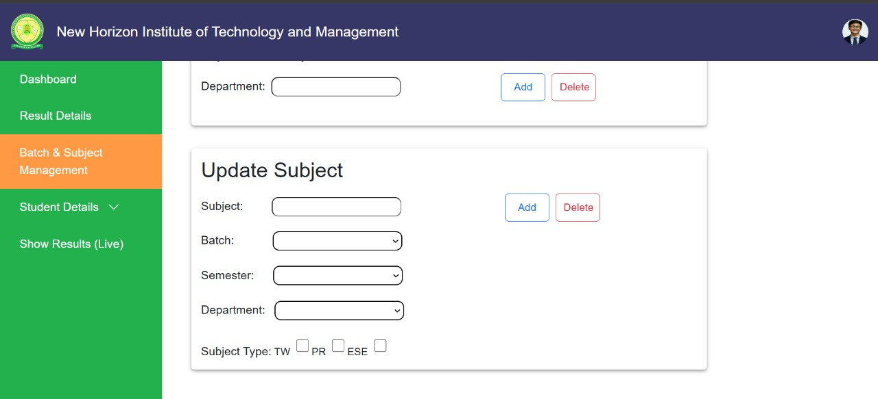
RESULT SCREENSHOTS

Slide 13
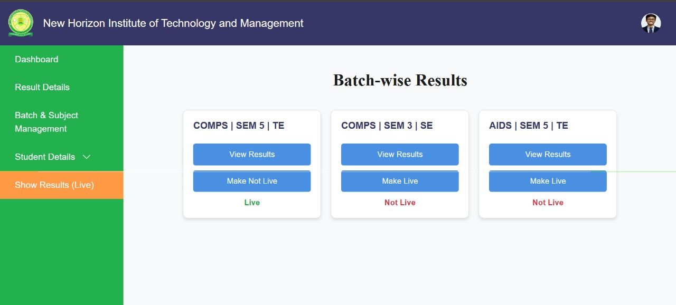
RESULT SCREENSHOTS

Slide 14
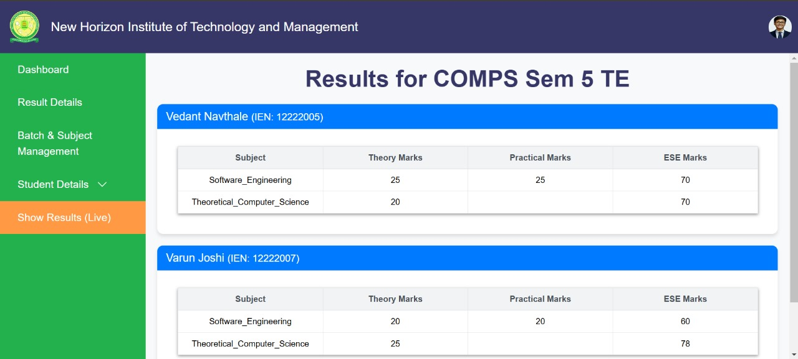
RESULT SCREENSHOTS

Slide 15
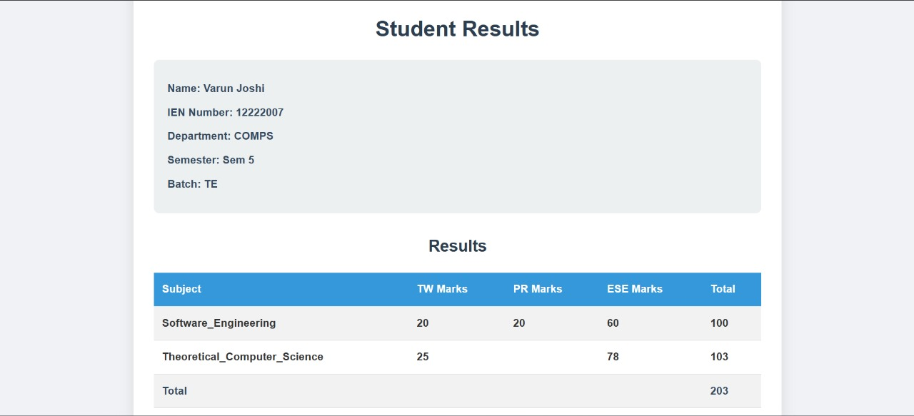
RESULT SCREENSHOTS

Slide 16
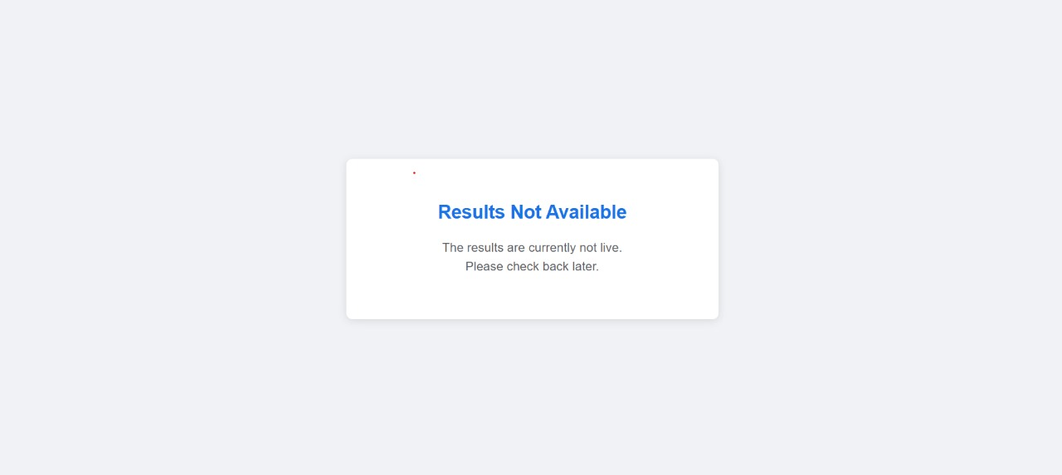
RESULT SCREENSHOTS

Slide 17
CONCLUSION
The Student Result Management System provides a seamless and efficient way for students and administrators to interact with academic data. Through OTP-based verification, students can securely access their results online, ensuring data privacy and accuracy. On the other hand, administrators are empowered with tools to manage student information, enter subject-wise results, and publish them in real time. This system not only eliminates the inefficiencies of traditional result distribution methods but also enhances accessibility and security. With its intuitive interface and role-based functionality, the platform ensures smooth user interactions, making it easier for students to stay updated and for administrators to handle academic data efficiently. Future enhancements, such as advanced analytics and performance tracking, can further improve the system’s capabilities, benefiting both students and administrators alike.

Slide 18
FUTURE SCOPE
Mobile Application: Develop a companion mobile app for DigiResult, allowing students and faculty to access results and manage data on-the-go.
Advanced Analytics Dashboard: Implement data visualization and analytics tools to provide insights on student performance trends, subject-wise analysis, and identify areas for improvement.
Integration with Other Systems: Connect DigiResult with other educational management systems like attendance tracking, library management, or learning management systems for a more comprehensive solution.
Automated Result Processing: Enhance the system to automatically calculate grades and GPAs based on predefined criteria, reducing manual work and potential errors.

Slide 19
FUTURE SCOPE
Expanded User Roles: Add more granular user roles and permissions, such as for department heads, exam coordinators, or academic advisors.
Batch Management Improvements: Enhance the batch and subject management features to handle more complex scenarios, like elective subjects or credit-based systems.
Document Generation: Add features to automatically generate transcripts, grade sheets, or certificates based on the stored results.
Plagiarism Detection: For courses with project submissions, integrate a plagiarism checking tool.
Performance Prediction: Implement machine learning algorithms to predict student performance based on historical data.

Slide 20
REFERENCES
[1] V. Rajpurohit, A. Kumar, and H. Kumar, “Student Result Management System (SRMS),” International Journal of Innovative Research in Science, Engineering and Technology (IJIRSET), vol. 11, no. 5, pp. 1-10, May 2022.
[2] M. G. Lorgat, "Web-Based Student Result Management System," Amity University, 2018.
[3] A. J. Ekanem, S. Ozuomba, and A. J. Jimoh, "Development of Students Result Management System: A Case Study of University of Uyo," Mathematical and Software Engineering, vol. 3, no. 1, pp. 26-42, 2017.

Slide 21


THANK YOU!

